Slide 1
Lecture 10: The Internet Technologies – Part 2
Connecting to a website, World Wide Web
Ravi Mittal
ravi.mittal@iitgoa.ac.in
Indian Institute of Technology, Goa

Slide 2
Contents
How do you connect to a website
IP packet routing
End-to-end protocols
WWW basics

Slide 3
How do you connect to a website ?

Slide 4
Basic lower layer technologies for Interconnection to the Internet
Internet works over link layer technologies
One of the following must be present
  Ethernet
  Wireless Ethernet, WiFi, Z wave
  Bluetooth, Zigbee
  RFID
  Cellular channel
  PPP
  Sonet
  ATM, Frame Relay
  L2TP
  etc

Slide 5


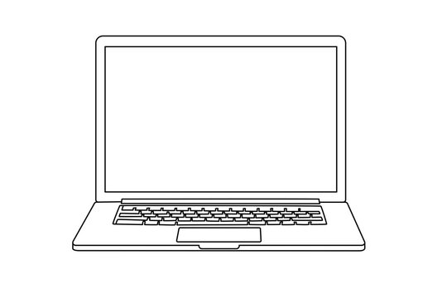
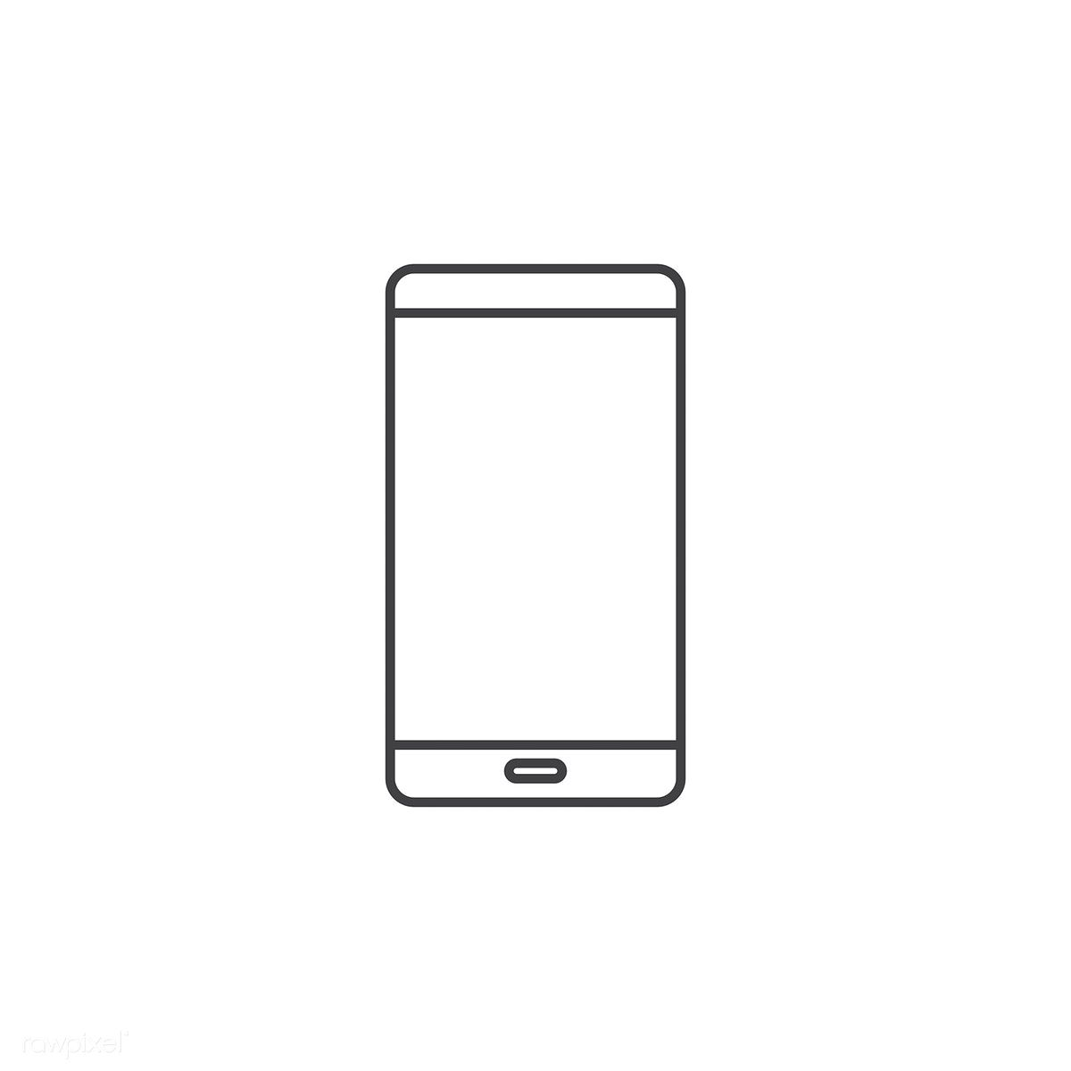
Connecting to a Server
Connection to ISP
Server

Slide 6
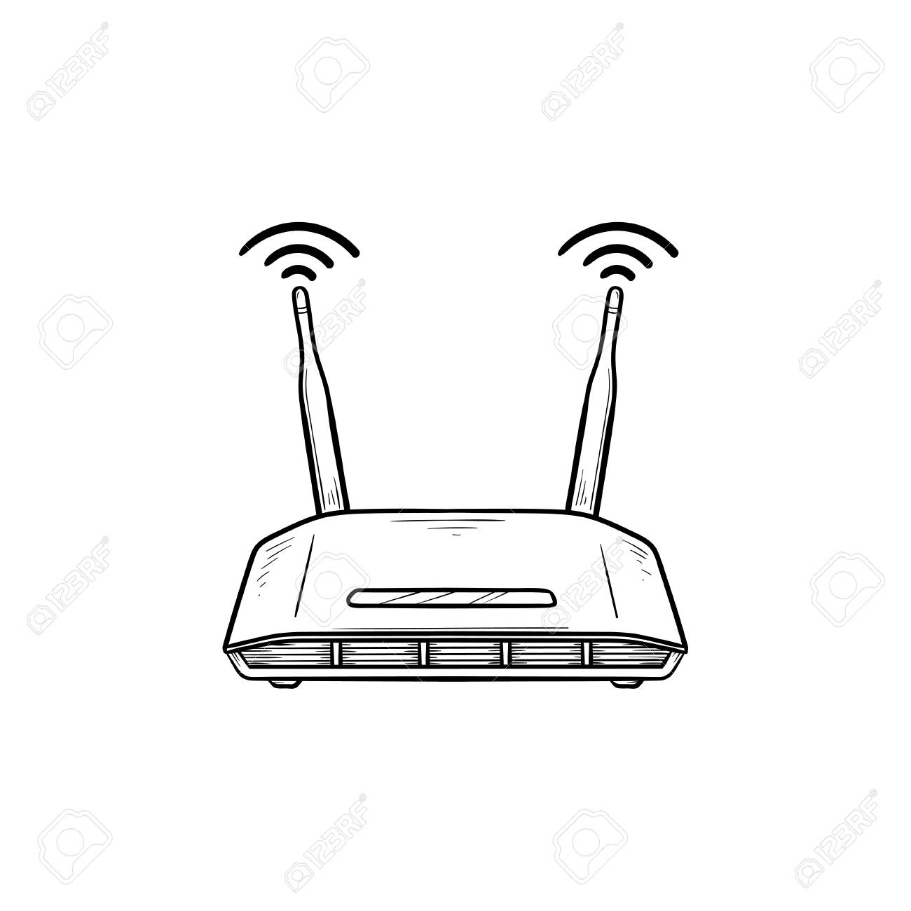
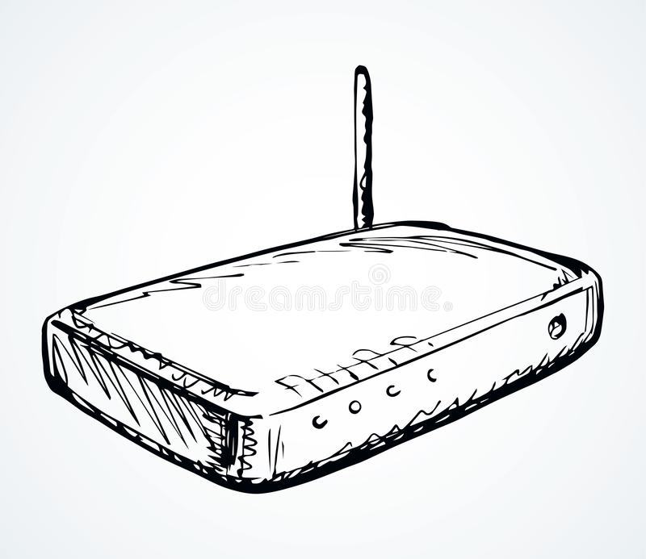
What devices you use to connect to Internet?
WiFi Router
Connected to service
Providers eg Airtel
Over Fiber/Ethernet
ADSL Modem connected
to service provider over
Telephone line

Slide 7
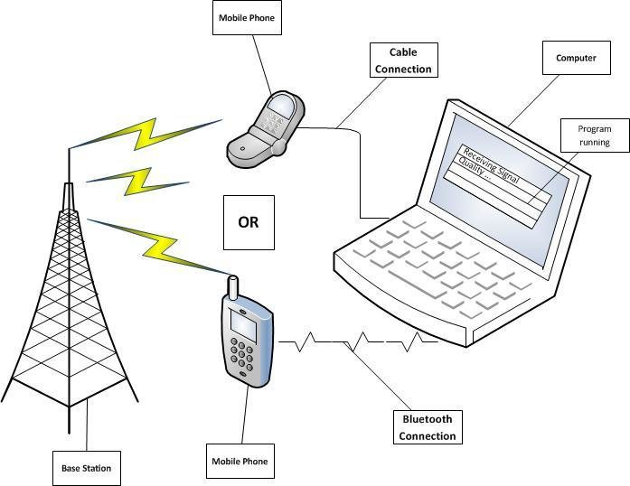
What devices you use to connect to Internet?
Use 3G/4G data-connection
Mobile Network

Slide 8
What we have seen so far is at very high level … abstract view
What goes on underneath? How 0s and 1s are transmitted?

Slide 9
To send a letter using postal service to your friend in some other city/Country, what do you need the most?

Slide 10
A very Unique Postal Address of the Receiver

Slide 11
Each sending and receiving machine must have unique IP address
The Internet too needs a uniquely defined addresses
IPv4 IP Address: 32 bits
#.#.#.#
4 numbers separated by .
Each number in the range: 0-255

Slide 12
Each sending and receiving machine must have unique IP address
In your device, where does this IP address come from?
IPv4 IP Address: 32 bits
#.#.#.#
4 numbers separated by .
Each number in the range: 0-255

Slide 13
Did you ever type these number like 10.200.128.66 in your laptop?
IPv4 IP Address: 32 bits
#.#.#.#
4 numbers separated by .
Each number in the range: 0-255

Slide 14
DHCP Protocol provides IP address to your device
ISP runs DHCP protocol
Your Router also run DHCP Protocol
IPv4 IP Address: 32 bits
#.#.#.#
4 numbers separated by .
Each number in the range: 0-255
IPv6 is becoming popular .. Address size 128 bits

Slide 15
Router first receives IP address from ISP for lease period using DHCP protocol
Each device connected to the Router needs an IP address
The DHCP Server in Router provides internal IP address to each device (using NAT)

Slide 16
Each website run on a server (or servers) with an IP address
We use websites such as
Google.com, Amazon.com, facebook.com
We don’t specify ip address for google.com
So there must be translation between domain name and ip address

Slide 17
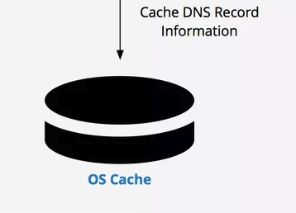
Domain Name Server

Slide 18



Slide 19
1. Join the wireless network
Your laptop shouts:
HEY, DOES WIRELESS NETWORK X EXIST?

Slide 20

1. Join the wireless network
Wireless access point(s) continually shout:
HEY, I’M WIRELESS NETWORK Y, JOIN ME!

Slide 21
1. Join the wireless network
If either match up, your laptop joins the network. Optionally performs a cryptographic exchange.

Slide 22
2. Configure your connection
Your laptop shouts:
HEY, ANYBODY, WHAT BASIC CONFIG DO I NEED TO USE?
I need IP address and
other parameters

Slide 23

2. Configure your connection
Some system on the local network replies: Here’s your config, enjoy
DHCP server

Slide 24
The configuration includes:
An Internet address (IP address) your laptop should use; typ. 32 bits (IPv4). May also include 64b of the 128b IPv6 address
The address of a “gateway” system to use to access hosts beyond the local network
The address of a DNS server (“resolver”) to map names like google.com to IP addresses
2. Configure your connection
192.168.1.14

Slide 25
3. Find the address of google.com
Your laptop sends a DNS request asking: “address for google.com?”
It’s transmitted using the UDP protocol (lightweight, unreliable).
The DNS resolver might not be on the local network.
192.168.1.14

Slide 26
3. Find the address of google.com
gateway
192.168.1.14

Slide 27
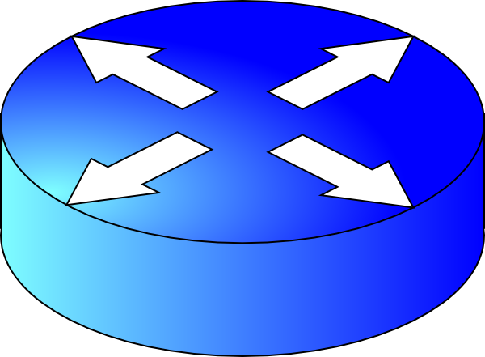
3. Find the address of google.com
gateway
192.168.1.14
The Rest of
the Internet
resolver
router
172.217.6.78

Slide 28
3. Find the address of google.com
google.com?
gateway
192.168.1.14
The Rest of
the Internet
resolver
router
172.217.6.78

Slide 29
3. Find the address of google.com
gateway
192.168.1.14
google.com?
The Rest of
the Internet
resolver
router
(The resolver now itself uses DNS queries to other DNS servers to figure out the address associated with google.com.)
172.217.6.78

Slide 30
3. Find the address of google.com
gateway
192.168.1.14
The Rest of
the Internet
resolver
router
google.com’s address is 172.217.6.78
172.217.6.78

Slide 31
4. Connect to google.com server
gateway
192.168.1.14
The Rest of
the Internet
resolver
router
172.217.6.78

Slide 32
IP Packet Routing

Slide 33
















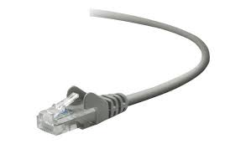
The Internet: a “nuts and bolts” view
Billions of connected computing devices:
  hosts = end systems
  running network apps at Internet’s “edge”
mobile network
national or global ISP
Packet switches: forward packets (chunks of data)
  routers, switches
local or regional ISP
Internet
Communication links
  fiber, copper, radio, satellite
  transmission rate: bandwidth
home network
content
provider
network
datacenter
network
Networks
  collection of devices, routers, links: managed by an organization
enterprise
network
Source: Kurose and Ross Book: 8th Edition

Slide 34
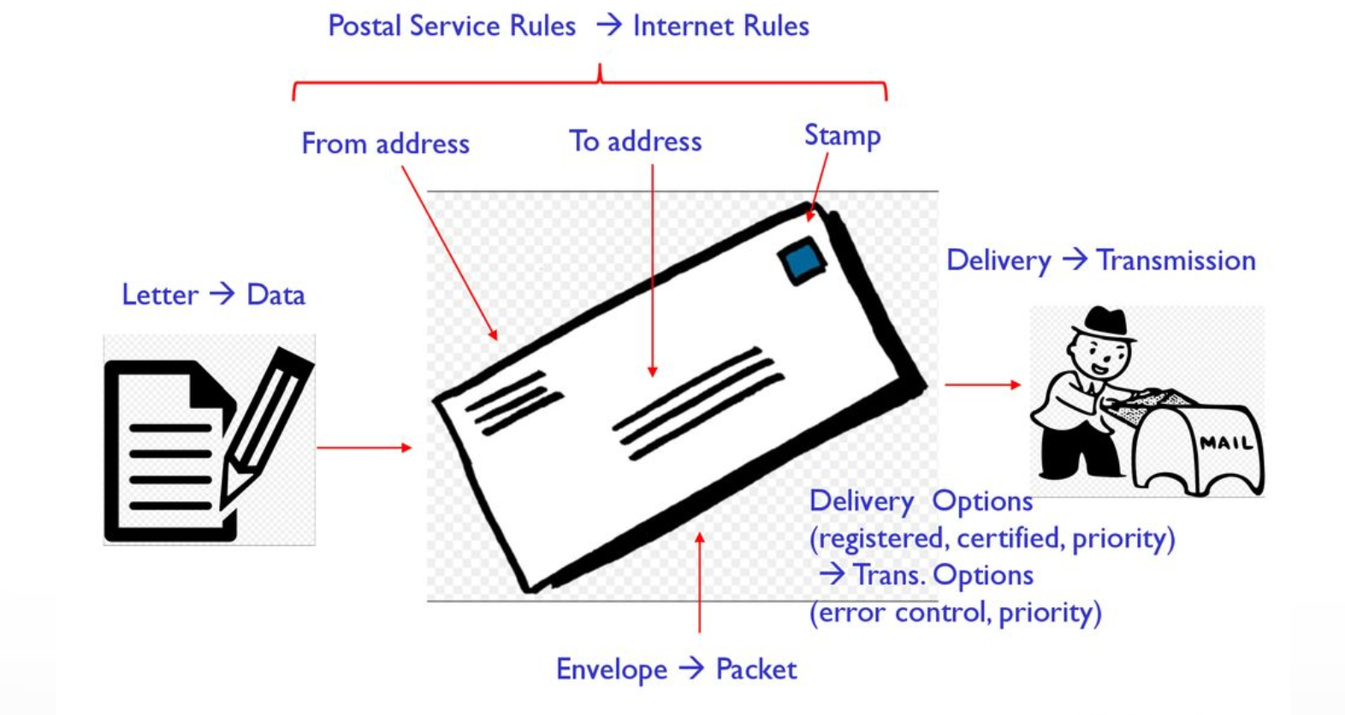
Postal System Analogy

Slide 35
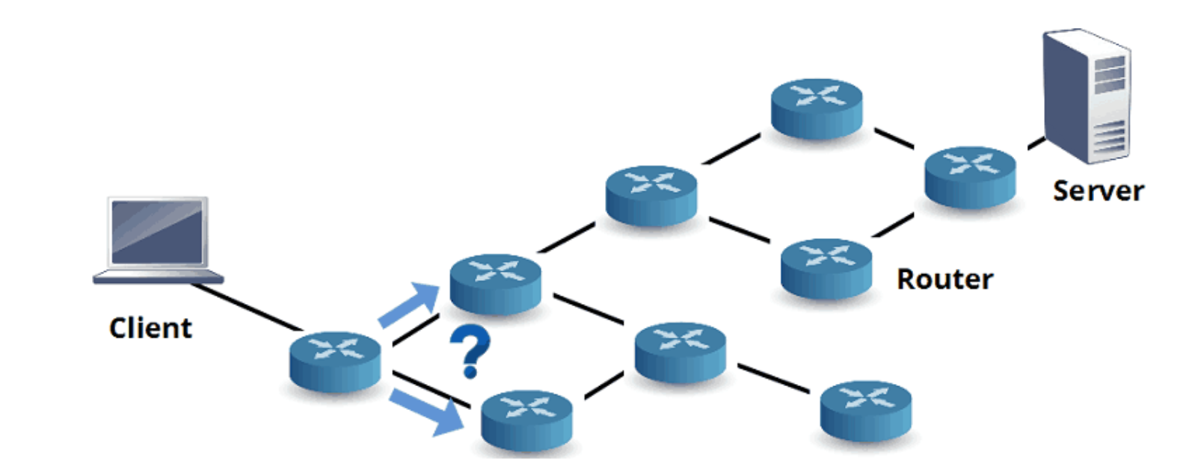

Slide 36
Packet Routing
routing algorithm determines
end-end-path through network
routing algorithm
forwarding table determines
local forwarding at this router
local forwarding table
dest address
output link
address-range 1
address-range 2
address-range 3
address-range 4
3
2
2
1
IP destination address in
arriving packet’s header
1
3
2
Source: Kurose and Ross Book: 8th Edition

Slide 37
End to End protocols

Slide 38
Integrated view of the Internet
mobile network
4G
national or global ISP
IP
Streaming
video
Skype
local or regional ISP
home network
content
provider
network
HTTP
datacenter
network
Ethernet
TCP
enterprise
network
WiFi
Source: Kurose and Ross Book: 8th Edition

Slide 39
Service view of the Internet
mobile network
national or global ISP
Streaming
video
Skype
local or regional ISP
home network
content
provider
network
HTTP
datacenter
network
enterprise
network
Source: Kurose and Ross Book: 8th Edition

Slide 40
Thousands of Networking Applications
social networking
Web
text messaging
e-mail
multi-user network games
streaming stored video (YouTube, Hulu, Netflix)
P2P file sharing
voice over IP (e.g., Skype)
real-time video conferencing (e.g., Zoom)
Internet search
remote login
File transfer

Slide 41
Website and Digital Transformation

Slide 42
Website and Digital Transformation
A company’s website plays a critical role in it’s Digital Transformation
Most websites perform across multiple devices
  Desktops
  Mobiles
  Tablets, ipad
Website is any organization’s very important digital asset
  Needs to be well designed
As number of mobile and Internet users are growing, powerful website becomes vital
A website must meet existing and future business objectives
First contact point for customers

Slide 43
Website – technical requirements
Designed to solve customer’s problems
Good integration with backend systems
  Servers, Server side logic, applications
  Databases, storages
  CRM
  Supply chain
  Data warehouses
  Payment systems, etc
Scalability
High Availability
High Agility
High Usability
Excellent UX design
Security

Slide 44
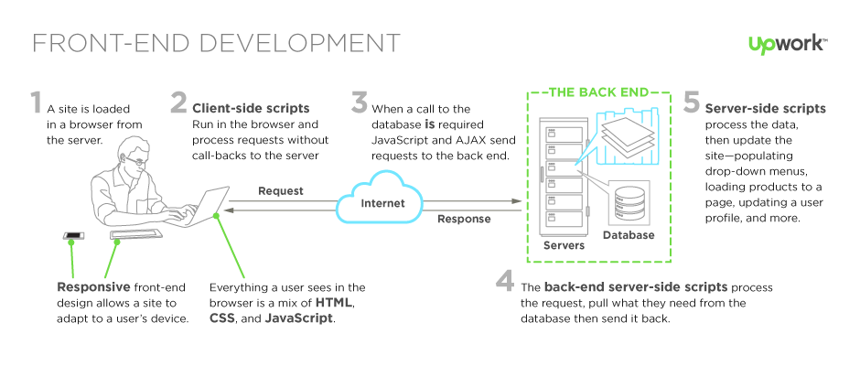
Front-end and Back-end

Slide 45
World Wide Web (www) - Basics

Slide 46

The Web – History
World Wide Web (WWW): a distributed database of “pages” linked through Hypertext Transport Protocol (HTTP)
  First HTTP implementation - 1990
    Tim Berners-Lee at CERN
  HTTP/0.9 – 1991
    Simple GET command for the Web
  HTTP/1.0 –1992
    Client/Server information, simple caching
  HTTP/1.1 - 1996
Tim Berners-Lee
Source: Sylvia Ratnasamy, Course CS 166, Univ of California, Berkeley

Slide 47
Web and HTTP
A web page consists of objects, each of which can be stored on different Web servers
Object can be HTML file, JPEG image, Java applet, audio file,…
Web page consists of base HTML-file which includes several referenced objects, each addressable by a URL, e.g.,
www.someschool.edu/someDept/pic.gif
host name
path name

Slide 48
Web Components
Client: web browsers, used to surf the Web
Server systems: used to supply information to these browsers
Computer networks: used to support the browser-server communication
  The Internet
Request “document A”
document A
Client
Server

Slide 49
Web Components
Content:
  URL: naming content
  HTML: formatting content
Protocol for exchanging information: HTTP
Source: Sylvia Ratnasamy, Course CS 166, Univ of California, Berkeley

Slide 50
Lecture - summary
The Internet plays a very crucial role in today’s businesses
The Internet runs over link layer technologies. Popular link layer technologies include: Ethernet, WiFi, and Cellular channels
To connect to any website (or any application), a laptop needs ip address
  DHCP server available in the local area network or outside, provides configuration parameters including ip address
To connect to a website, a laptop (or any other device) needs to resolve http address to ip address
  This is done using DNS – domain name server
Website of a business plays a very critical role in digital transformation

Slide 51
Backup Slides

Slide 52
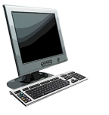

HTTP overview
HTTP: hypertext transfer protocol
Web’s application-layer protocol
client/server model:
  client: browser that requests, receives, (using HTTP protocol) and “displays” Web objects
  server: Web server sends (using HTTP protocol) objects in response to requests
PC running
Firefox browser
HTTP request
HTTP response
HTTP request
server running
Apache Web
server
HTTP response
iPhone running
Safari browser

Slide 53
HTTP overview (continued)
HTTP uses TCP:
client initiates TCP connection (creates socket) to server, port 80
server accepts TCP connection from client
HTTP messages (application-layer protocol messages) exchanged between browser (HTTP client) and Web server (HTTP server)
TCP connection closed
HTTP is “stateless”
server maintains no information about past client requests
aside
protocols that maintain “state” are complex!
past history (state) must be maintained
if server/client crashes, their views of “state” may be inconsistent, must be reconciled

Slide 54
Basics of the WWW
Hypertext: a format of information which allows one to move from one part of a document to another or from one document to another through hyperlinks
Uniform Resource Locator (URL): unique identifiers used to locate a particular resource on the network
Markup language: defines the structure and content of hypertext documents

Slide 55
Static Web: HTML/XHTML, CSS
HTML stands for HyperText Markup Language
  It is a text file containing small markup tags that tell the Web browser how to display the page
XHTML stands for eXtensible HyperText Markup Language
  It is identical to HTML 4.01
  It is a stricter and cleaner version of HTML
CSS stands for Cascading Style Sheets
  It defines how to display HTML elements

Slide 56
Why Programmability?
What’s the drawback to simple document model?
  Static

Slide 57
Client-Side Programmability
Scripting language: a lightweight programming language
Browser scripting: JavaScript
  Designed to add interactivity to HTML pages
  Usually embedded into HTML pages
  What can a JavaScript Do?
    Put dynamic text into an HTML page
    React to events
    Read and write HTML elements
    Validate data before it is submitted to a server
    Create cookies
    …

Slide 58
Server-Side Programmability
The requests cause the response to be generated
Server scripting:
  CGI/Perl: Common Gate Way Interface (*.pl, *.cgi)
  PHP: Open source, strong database support (*.php)
  ASP: Microsoft product, uses .Net framework (*.asp)
  Java via JavaServer Pages (*.jsp)
  …

Slide 59
CGI
Common Gateway Interface:
  CGI provides a way by which a web server can obtain data from (or send data to) database, and other programs, and present that data to viewers via the web.
  A CGI program can be written in any programming language, but Perl is one of the most popular

